Slide 1

Scaling SQL Server Beyond 2 CPU’s
Beyond 1 Core
=tg= Thomas Grohser

Slide 2


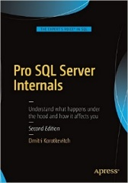

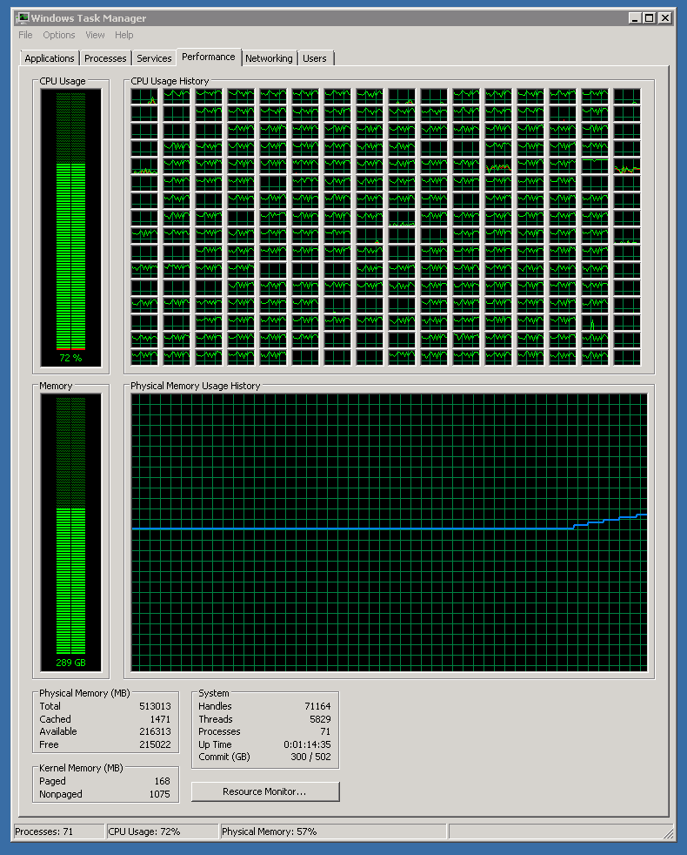

select * from =tg= where topic =
@@Version | Remark
SQL 4.21 | First SQL Server ever used (1994)
SQL 6.0 | First Log Shipping with failover
SQL 6.5 | First SQL Server Cluster (NT4.0 + Wolfpack)
SQL 7.0 | 2+ billion rows / month in a single Table
SQL 2000 | 938 days with 100% availability
SQL 2000 IA64 | First SQL Server on Itanium IA64
SQL 2005 IA64 | First OLTP long distance database mirroring
SQL 2008 IA64 | First Replication into mirrored databases
SQL 2008R2 IA64 SQL 2008R2 x64 | First 256 CPUs & >500.000 STMT/sec First Scale out > 1.000.000 STMT/sec First time 1.2+ trillion rows in a table
SQL 2012 | > 220.000 Transactions per second > 1.3 Trillion Rows in a table
SQL 2014 | > 400.000 Transactions per second Fully automated deploy and management
SQL 2016 | AlwaysOn Automatic HA and DR, crossed the PB in storage
SQL 2017 | In production 3 minutes after RTM
SQL 2019 | > 3 trillion rows in one table > 10 PB of data
vNext | Can’t wait to push the limits even further
=tg= Thomas Grohser,
Enterprise Database Infrastructure Architect and Engineer
email: tg@grohser.com
Focus on SQL Server Security, Performance Engineering,
Infrastructure and Architecture
Wrote some of
Close Relationship with
SQLCAT (SQL Server Customer Advisory Team)
SCAN (SQL Server Customer Advisory Network)
TAP (Technology Adoption Program)
Product Teams in Redmond

Slide 3

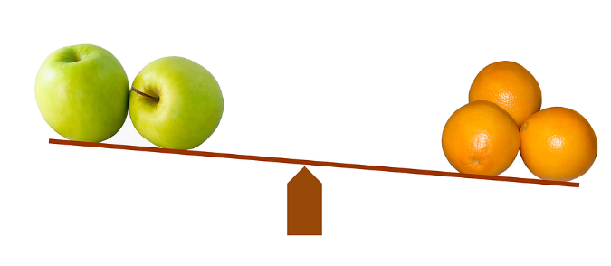






Before we Start: How to Compare Stuff
Marketing

Slide 4




Sample Workloads
Low Latency
Few (maybe even just one) connections, fastest possible response time
High Concurrency OLTP
Lots of concurrent connections
High Throughput DSS/DWH/Analytics
Few but complex requests touching a lot of data
Generic Server and Virtualization

Slide 5
Scaling Parallel Workloads Theory

Slide 6
The Tools in the Scale Toolbox
Optimize
Get the work done by doing the steps needed more efficient with the resources you have
Reduce
Do less work. Find a way to get to the same result with less steps or easier steps
Scale Up
Do it on a faster server or in parallel on the same server
Scale Out
Spread the work to many servers in parallel

Slide 7
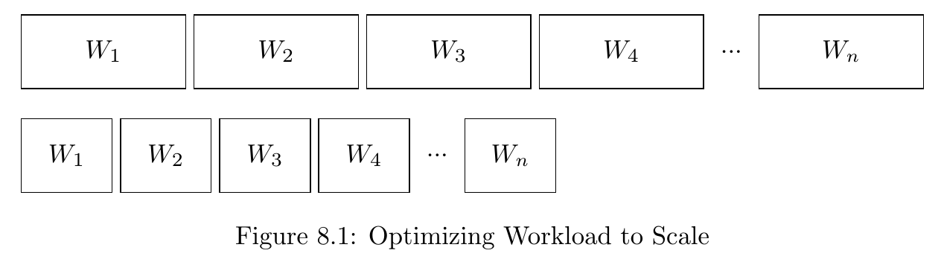
Optimize

Slide 8
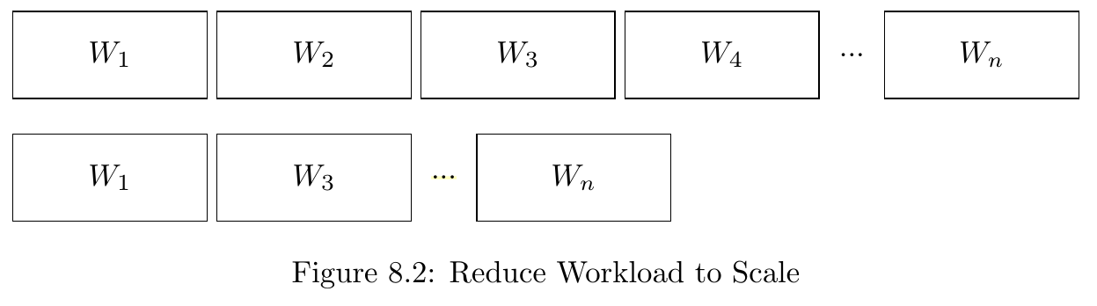
Reduce

Slide 9
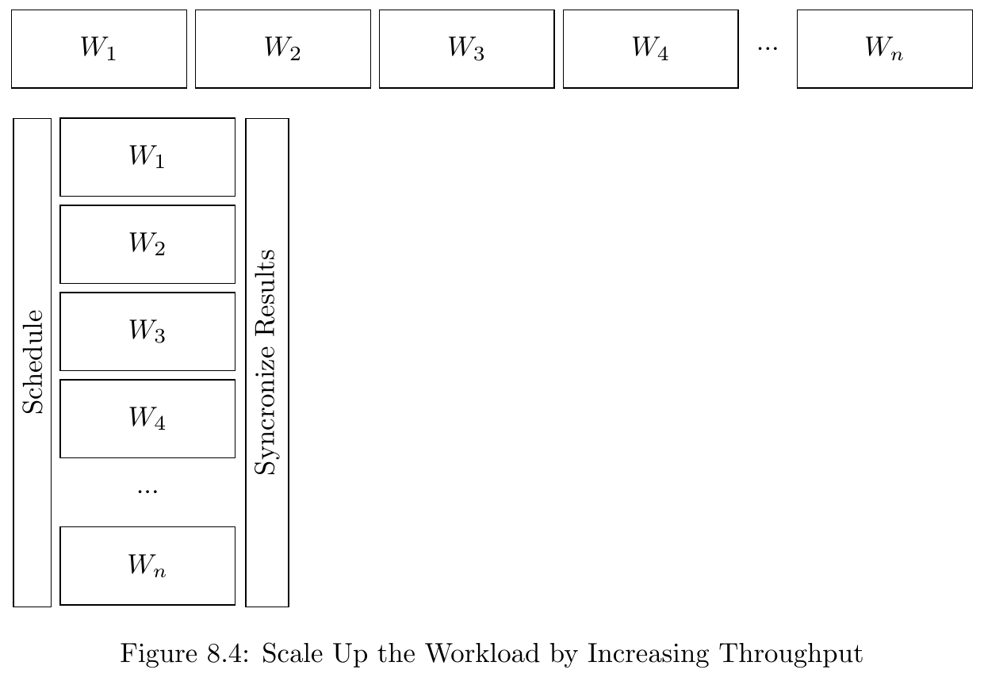
Scale Up

Slide 10
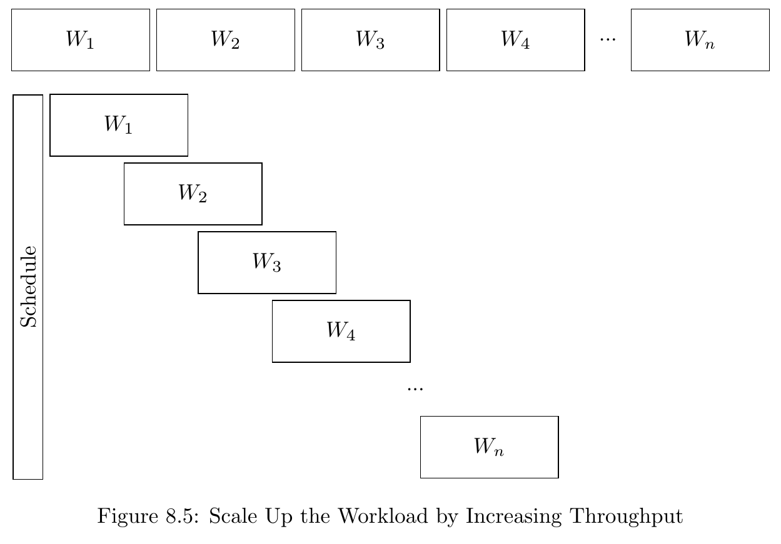
Scale Up with dependency between tasks

Slide 11
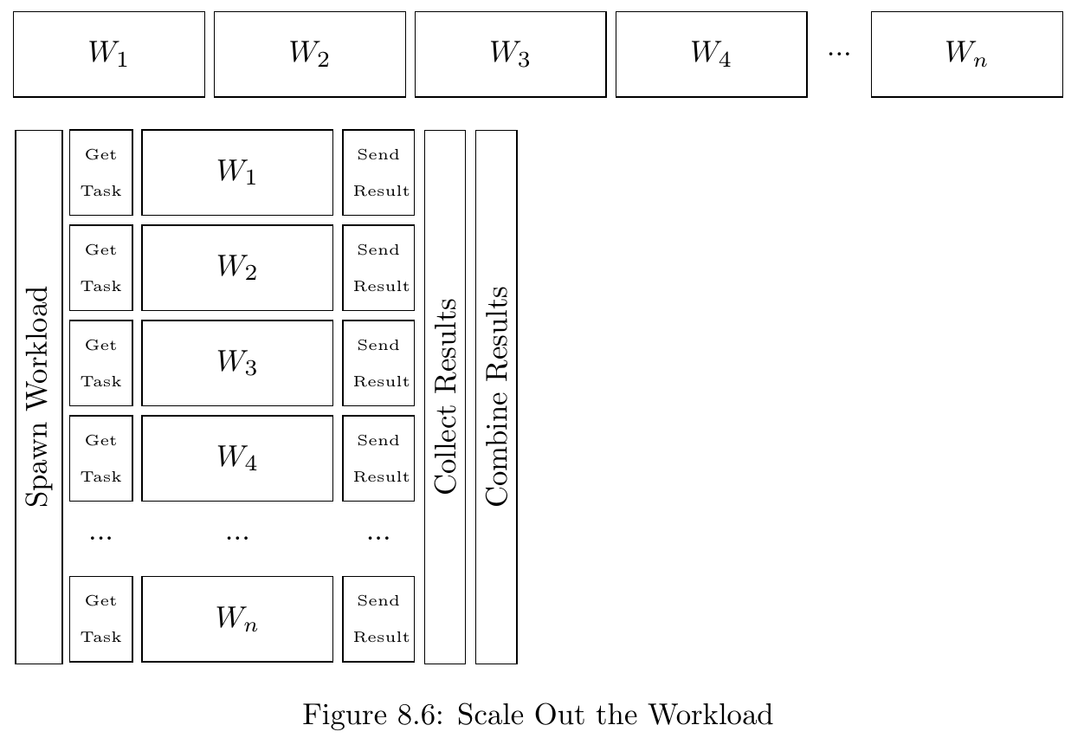
Scale Out

Slide 12
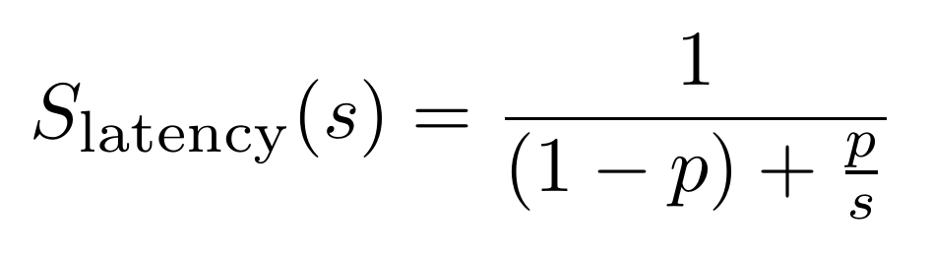
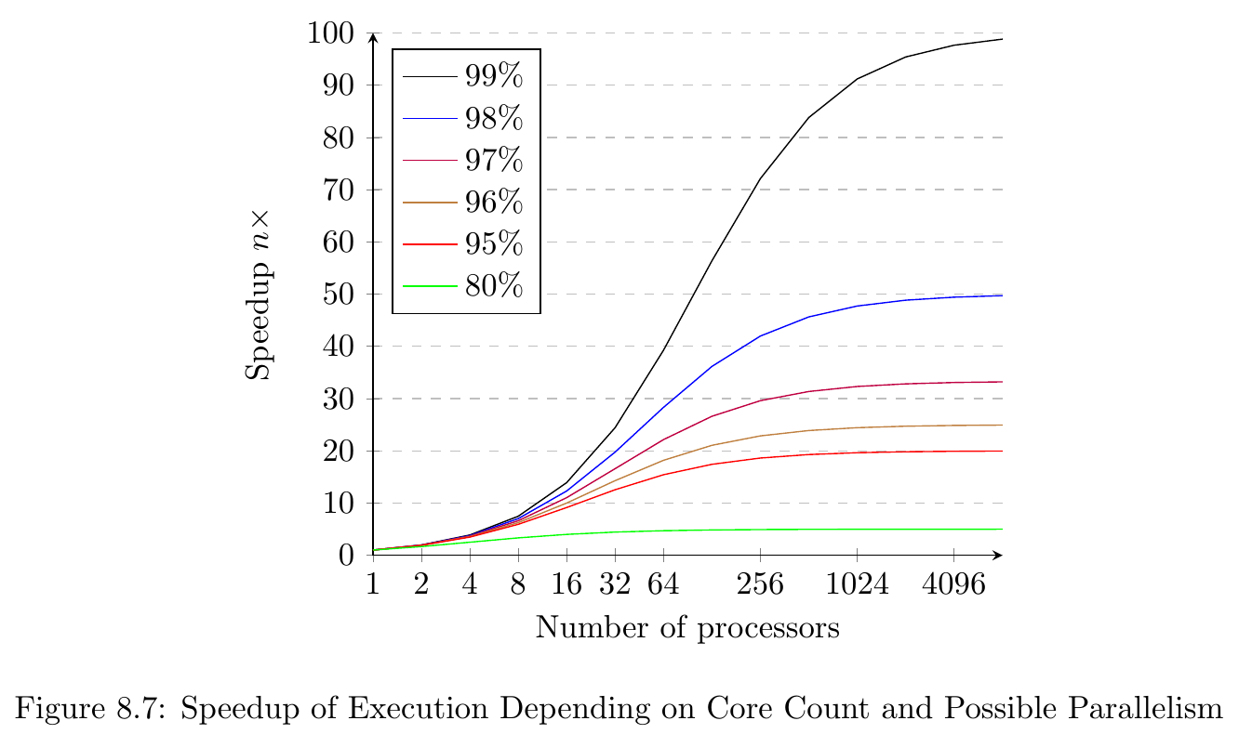
Amdahl’s Law
p … is the proportion of execution time that the part benefiting from improved resources originally occupied. With other words the percentage of how much of your execution can be run in parallel.
s … is the speedup of the part of the task that benefits from improved system resources or with other words the number of cores you have available to execute the workload.

Slide 13
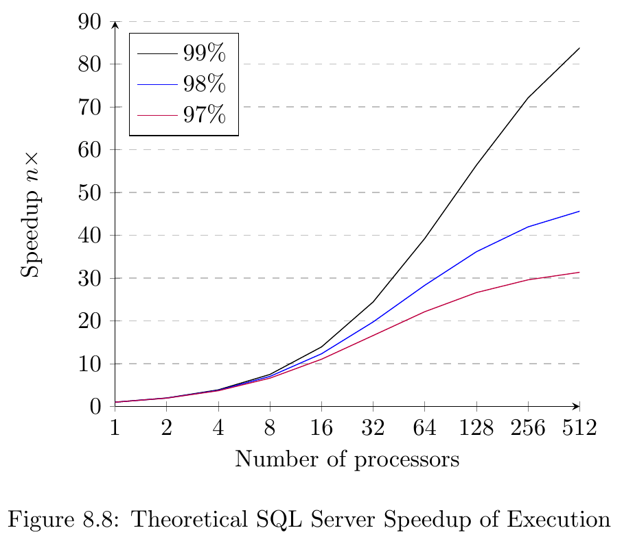
Amdahl’s Law applied to SQL Server

Slide 14
1 to 32 CPU’s
Looking at CPU and Memory

Slide 15
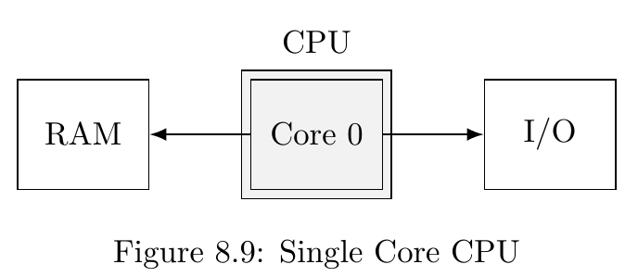
A long time ago in a server far, far away…

Slide 16
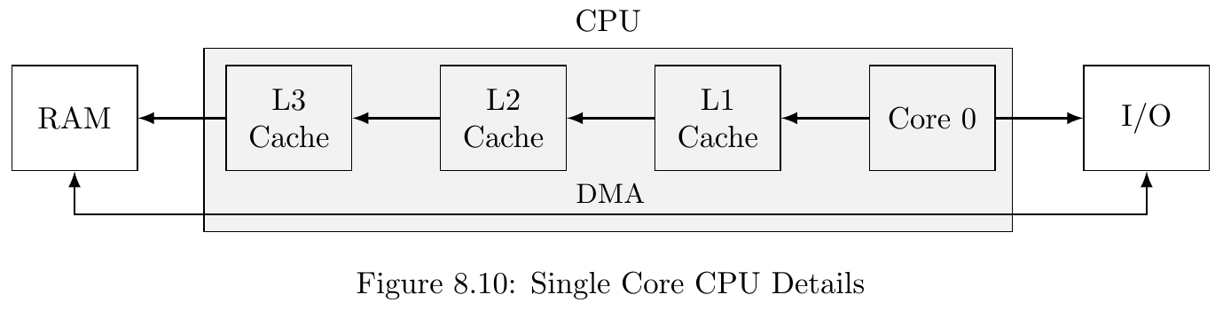
How cache for memory changes this

Slide 17
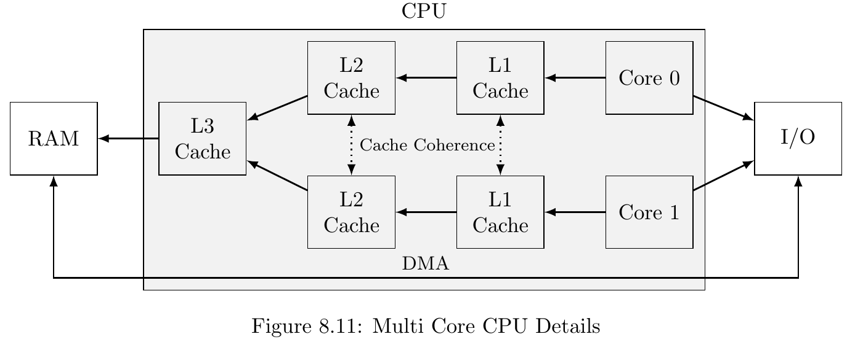
Adding a second core…

Slide 18
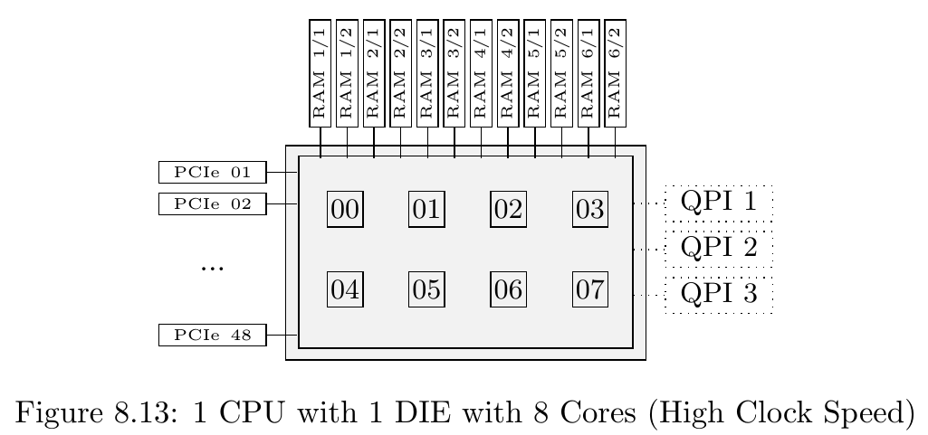
Modern CPU single DIE CPU

Slide 19
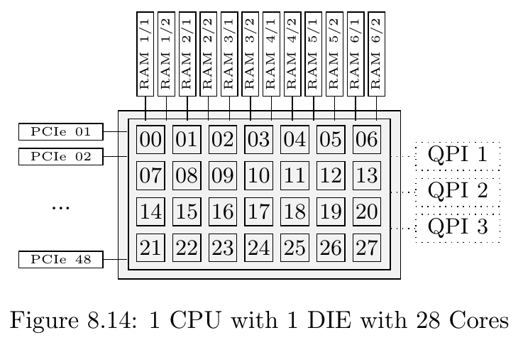
High Core CPU on a Single DIE

Slide 20

Use Single CPU for
Low Latency
Few (maybe even just one) connections, fastest possible response time
High Concurrency OLTP
Lots of concurrent connections
High Throughput DSS/DWH/Analytics
Few but complex requests touching a lot of data
Generic Server and Virtualization
This Photo by Unknown Author is licensed under CC BY-SA

Slide 21
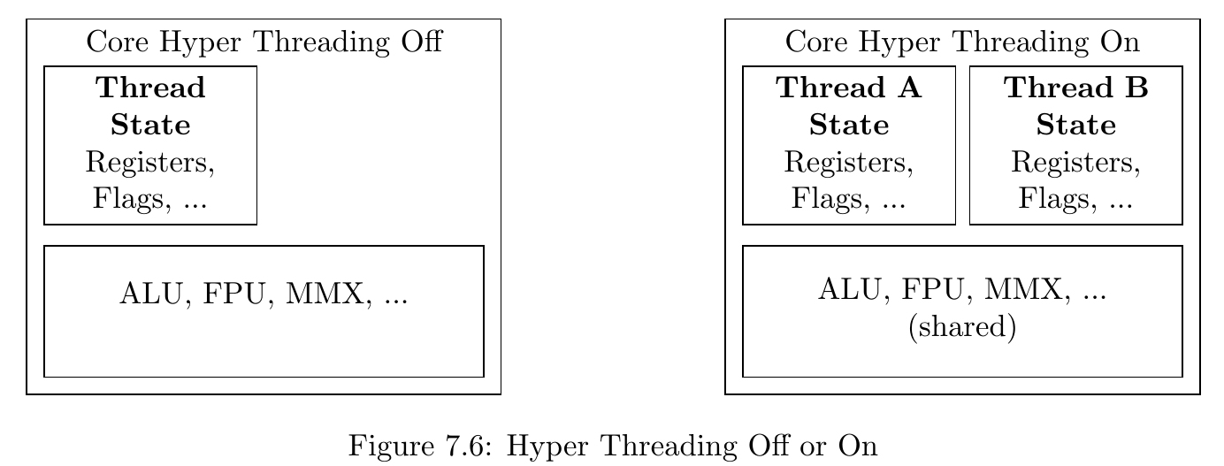
Hyper Threading
From a single thread perspective minus 30-40% performance
From an overall perspective 20-40% gain

Slide 22
Use Hyper Threading
Low Latency
Few (maybe even just one) connections, fastest possible response time
High Concurrency OLTP
Lots of concurrent connections
High Throughput
DSS/DWH/Analytics
Few but complex requests touching a lot of data
Generic Server and Virtualization

Slide 23
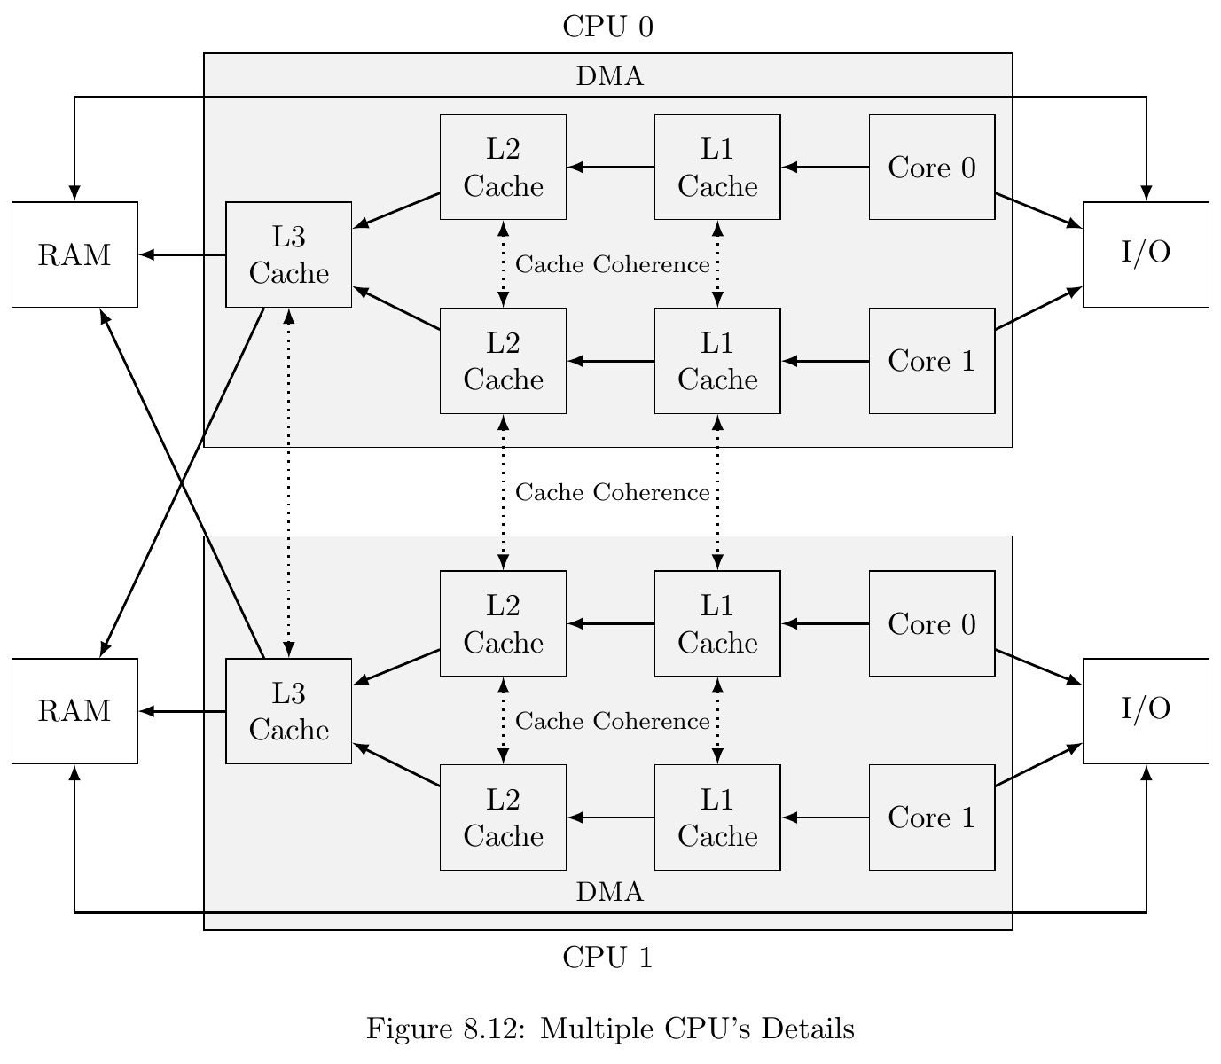
Adding a second CPU…
Memory access
Goes up from 76ns on a single CPU to 89ns local and 139ns remote when using multiple CPU’s

Slide 24
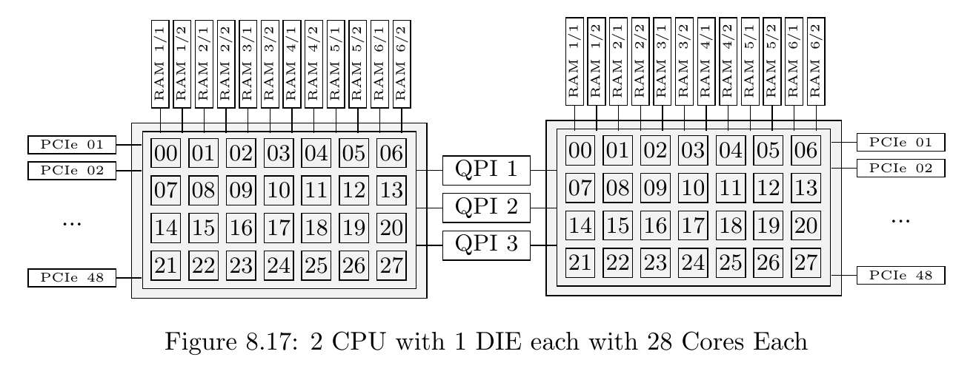
Two CPU’s one DIE each

Slide 25
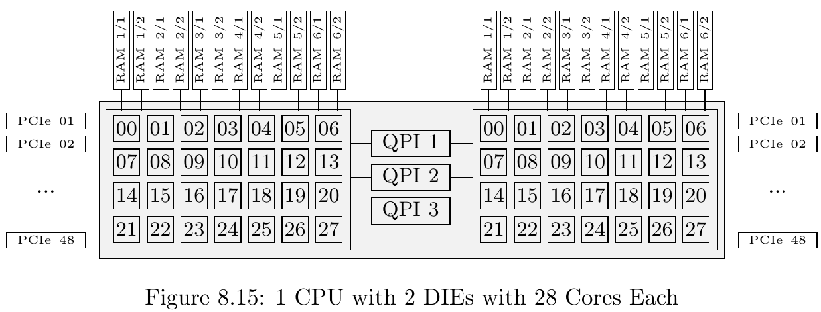
One CPU - Two DIE

Slide 26
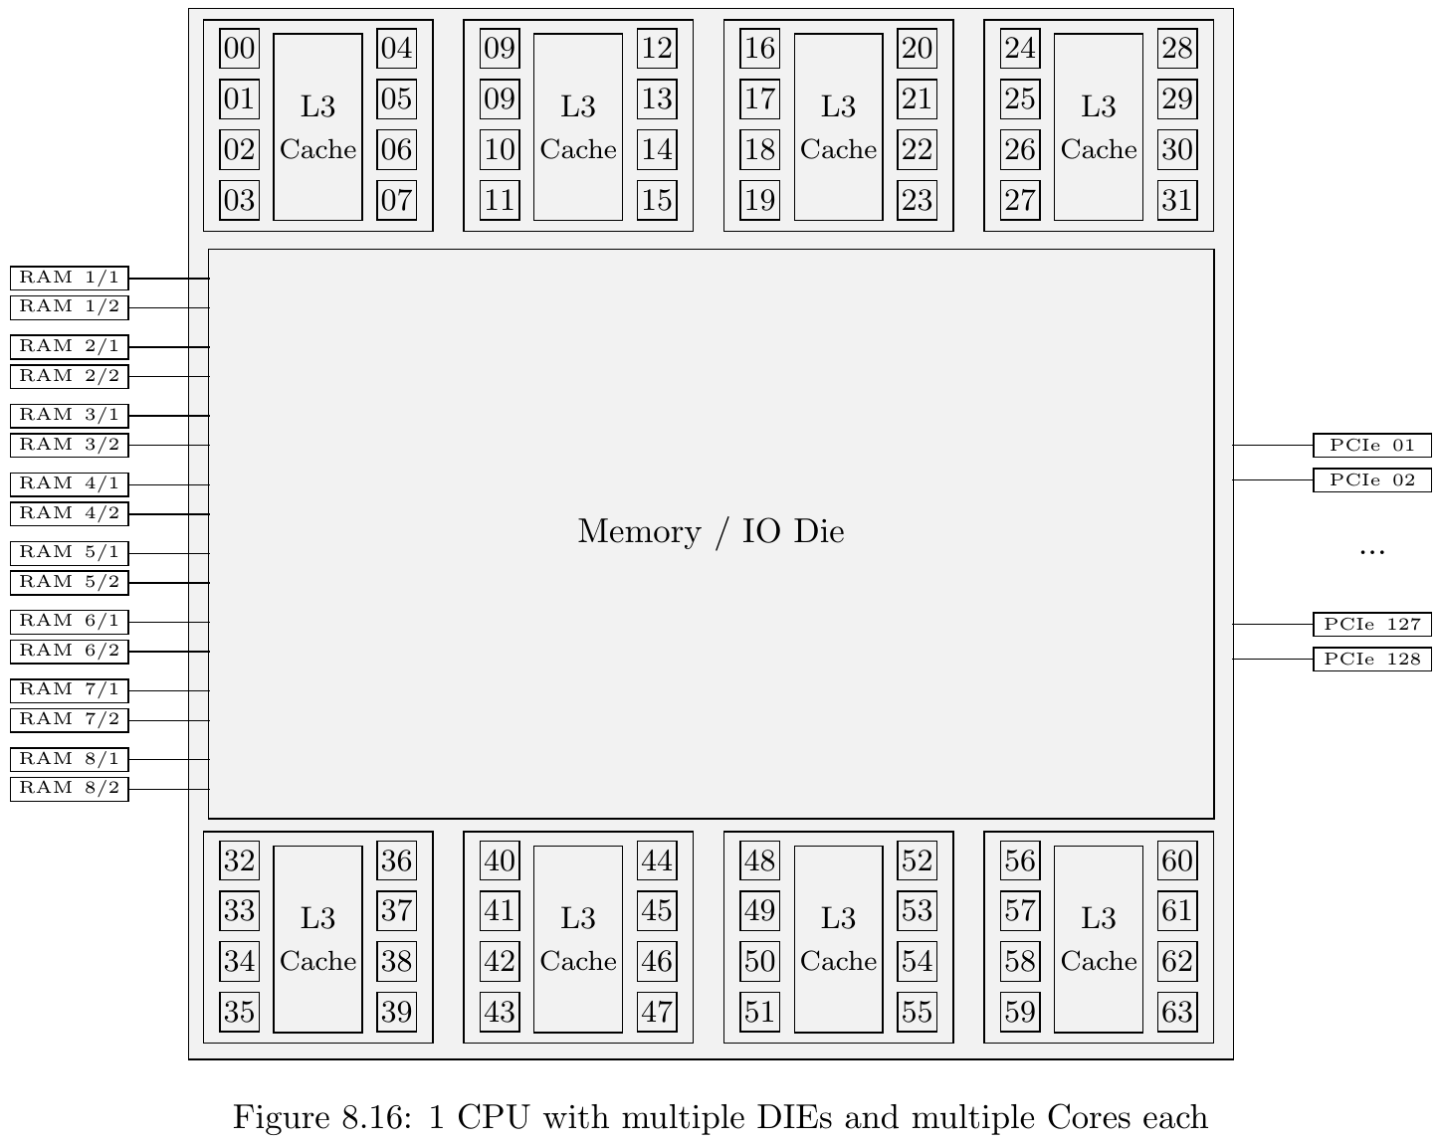
Multi DIE with centralized IO

Slide 27
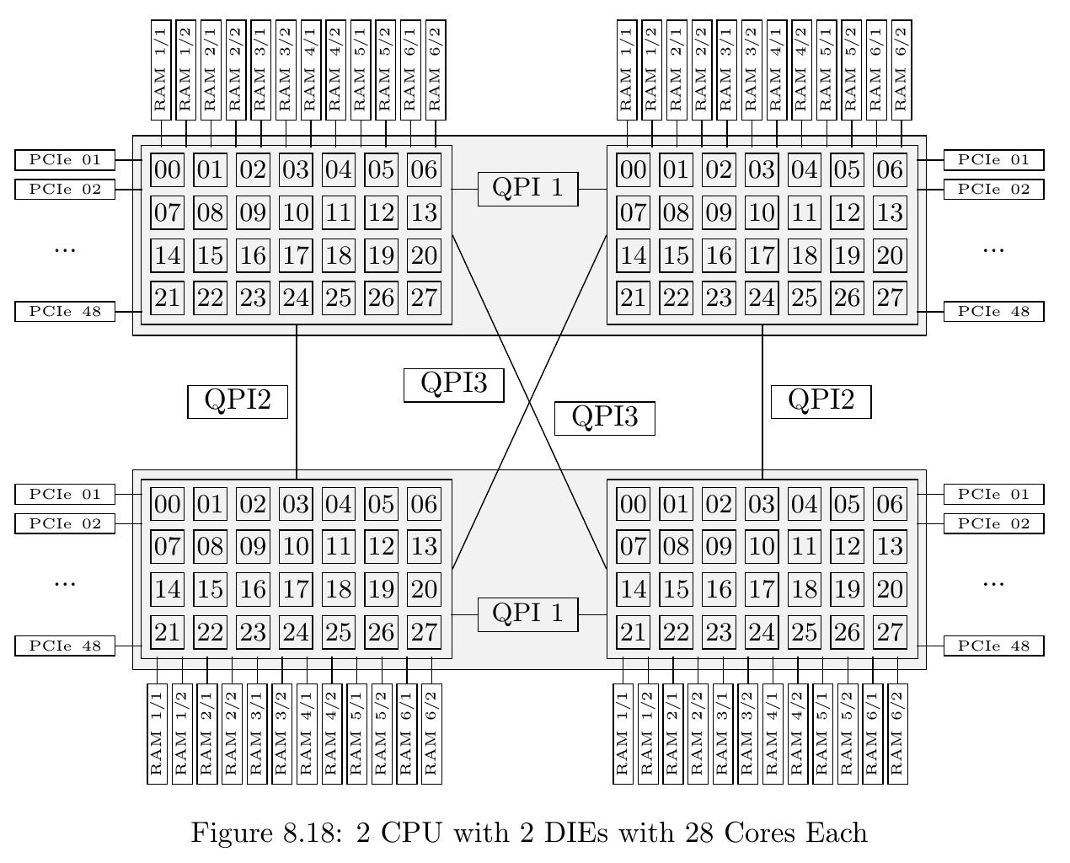
Two CPU’s Two DIE each

Slide 28
Use Dual CPU for
Low Latency
Few (maybe even just one) connections, fastest possible response time
High Concurrency OLTP
Lots of concurrent connections
High Throughput DSS/DWH/Analytics
Few but complex requests touching a lot of data
Generic Server and Virtualization
This Photo by Unknown Author is licensed under CC BY-SA

Slide 29
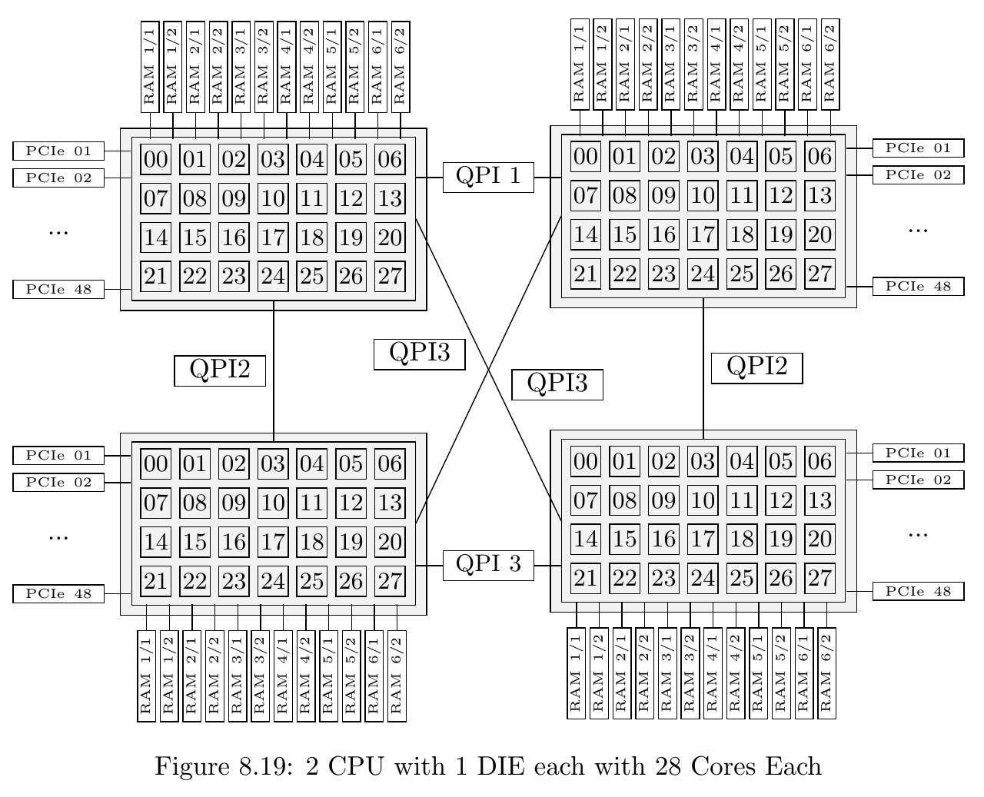
4 CPU’s

Slide 30
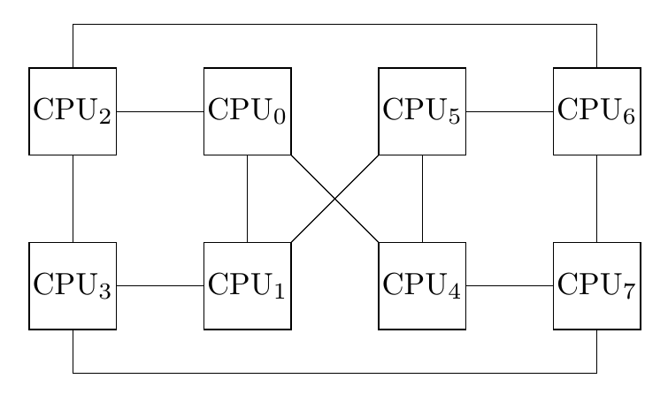
8 CPU’s
Not all CPU’s are connected directly anymore.
Now 3 levels of memory latency (local, remote, remote via hop)
Bandwidth between CPU’s down to 1/3 of dual socket
Even down up to 1/6 due to possible sharing of a link due to a remote via hop access

Slide 31
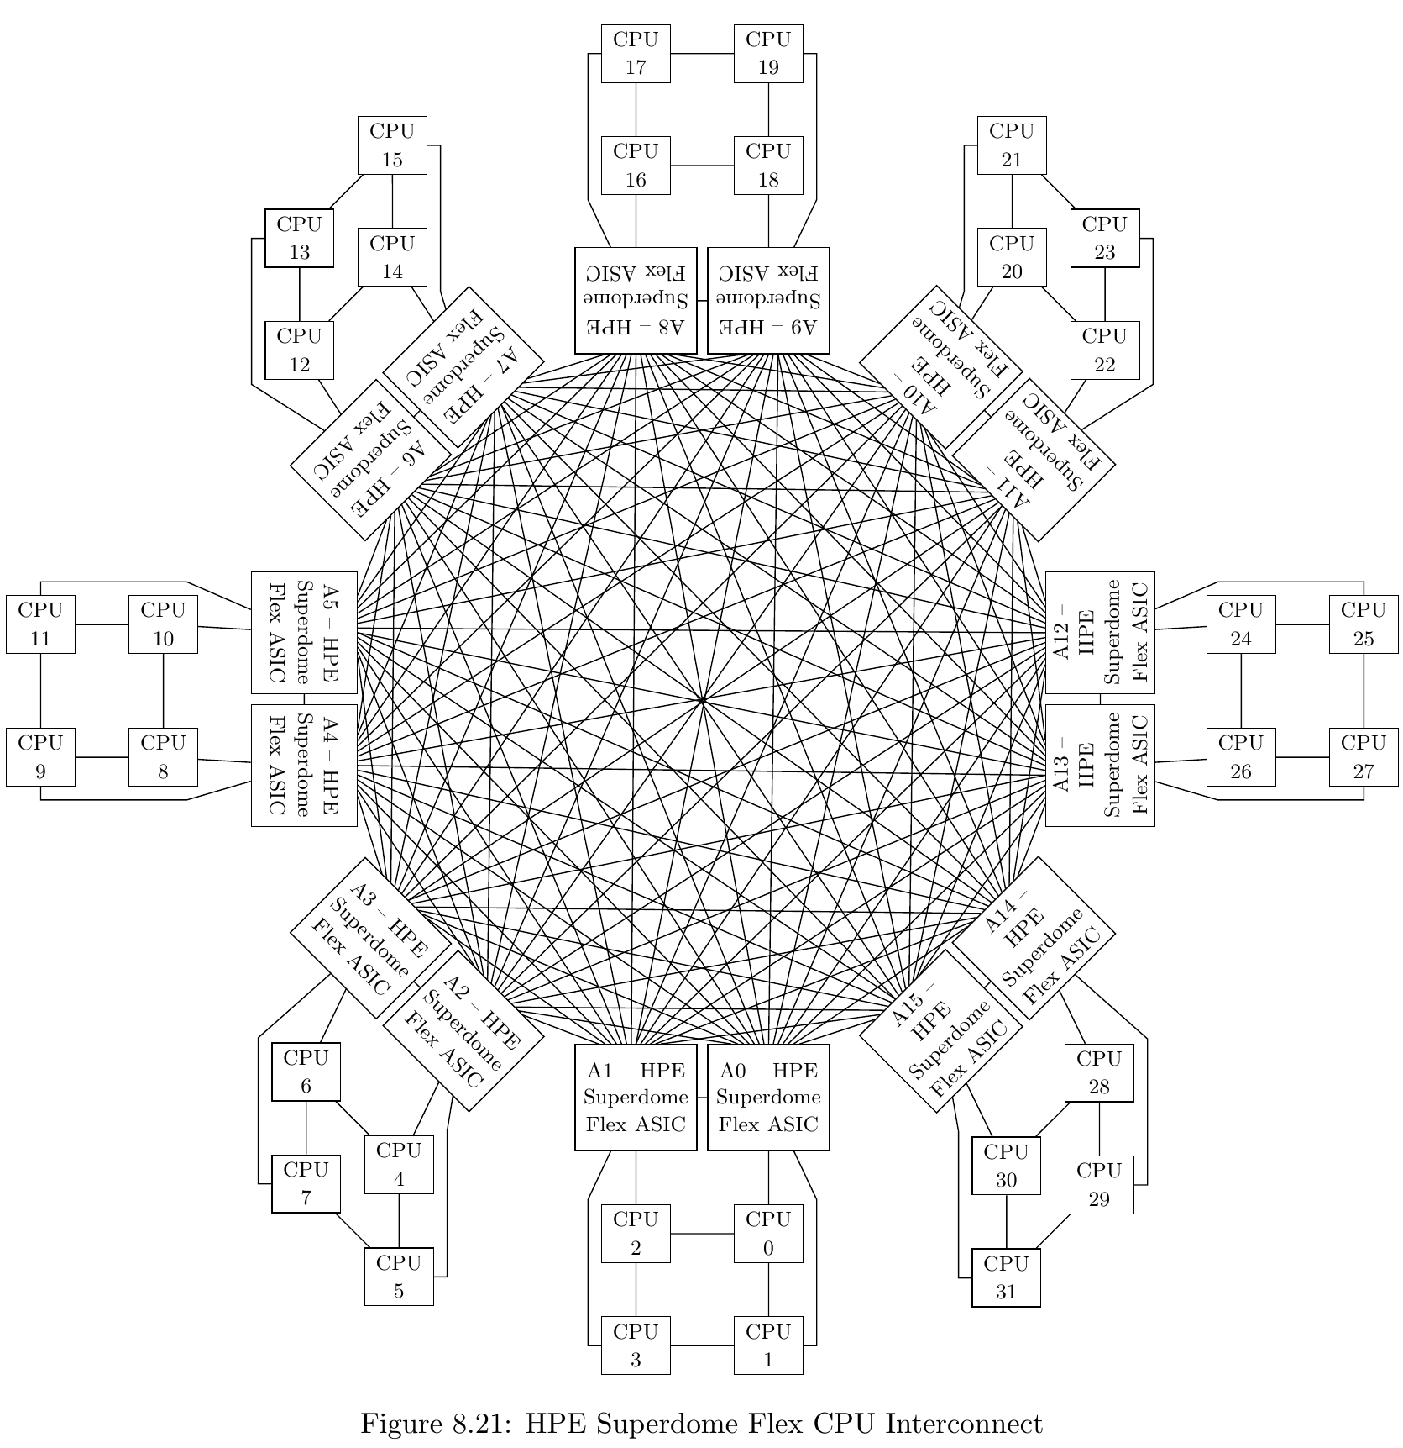
32 CPU’s
Not much “worse” than 8 CPU’s
Within 4 CPU node same as 8 Socket
Node to Node communication via custom ASIC connected to each CPU
→ slightly higher latency (ASIC overhead)
Therefor about same throughput than in 8 sockets (minus ASIC overhead)
The more sockets the more important it becomes to actively support NUMA

Slide 32
Use 4 and 8 and more CPU for
Low Latency
Few (maybe even just one) connections, fastest possible response time
High Concurrency OLTP
Lots of concurrent connections
High Throughput
DSS/DWH/Analytics
Few but complex requests touching a lot of data
Generic Server and Virtualization
This Photo by Unknown Author is licensed under CC BY-SA

Slide 33
NUMA

Slide 34
Soft NUMA
IP/Port
IP/Port
IP/Port
IP/Port
IP/Port
Core + Cache
Core + Cache
Core + Cache
Core + Cache
Core + Cache
…
Range of
Data
Range of
Data
Range of
Data
Range of
Data
Range of
Data

Slide 35
Super/Sub Latches
You will encounter them on systems with many NUMA nodes and cores
Duplicates very active pages that are mostly read only (e.g. index root pages) to every NUMA Node
For reads all you need is a latch in the local copy.
For writes a latch on all copies is required

Slide 36
Actively Support NUMA
Low Latency
Few (maybe even just one) connections, fastest possible response time
High Concurrency OLTP
Lots of concurrent connections
High Throughput
DSS/DWH/Analytics
Few but complex requests touching a lot of data
Generic Server and Virtualization

Slide 37
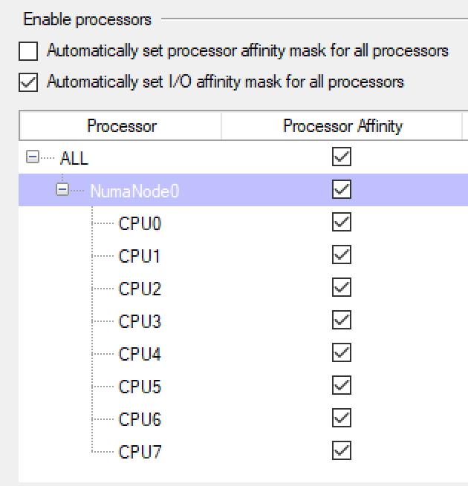
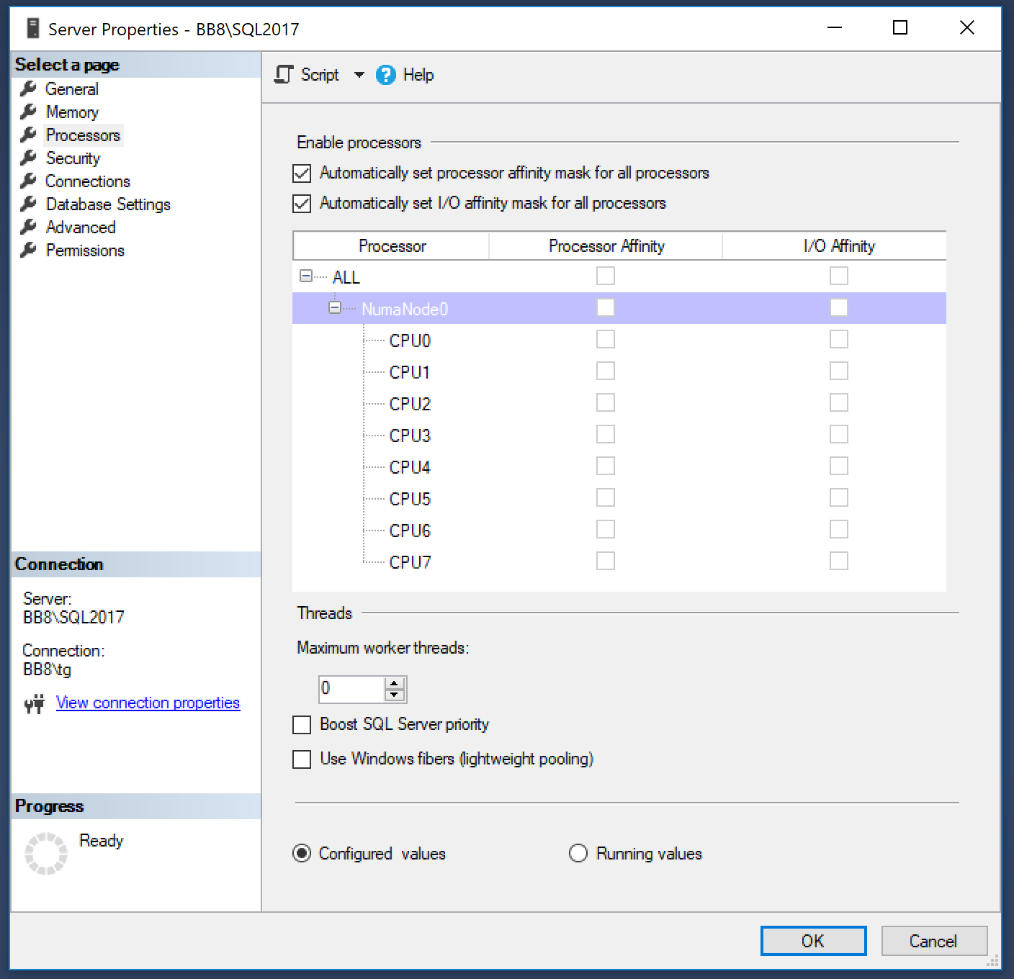
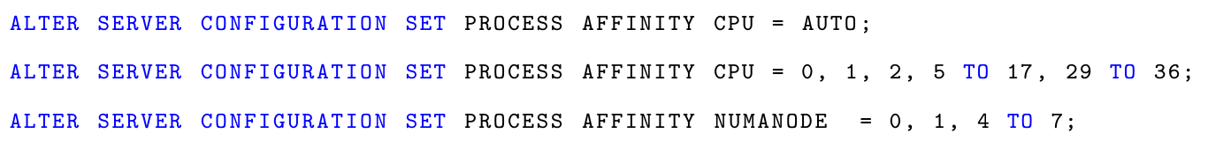
CPU Affinity
Query
Worker Thread
Scheduler
Scheduler
Core
Core
Auto – Migrate between all schedulers/cores
Affinity Set – Use only selected schedulers/cores stay on scheduler you start on
Affinity Set + TF 8002 – Migrate between selected schedulers/cores

Slide 38
Set CPU Affinity for
Low Latency
Few (maybe even just one) connections, fastest possible response time
High Concurrency OLTP
Lots of concurrent connections
High Throughput
DSS/DWH/Analytics
Few but complex requests touching a lot of data
Generic Server and Virtualization

Slide 39
Scaling IO As Well

Slide 40
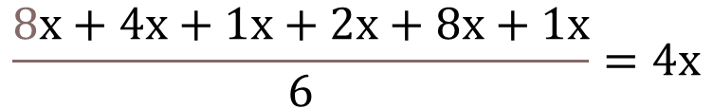
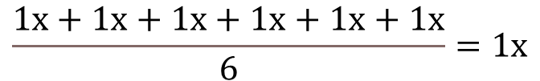
Scale Up – The Wrong Approach
CPU 1X
Memory 1X
Network 1X
IO 1X
IO 2X
CPU 8X
Memory 4X
Network 1X
Capacity 1X
Capacity 8X
Latency 1X
Latency 1X
$$\frac{1x+1x+1x+1x+1x+1x}{6}=1x$$
$$\frac{8x+4x+1x+2x+8x+1x}{6}=4x$$

Slide 41
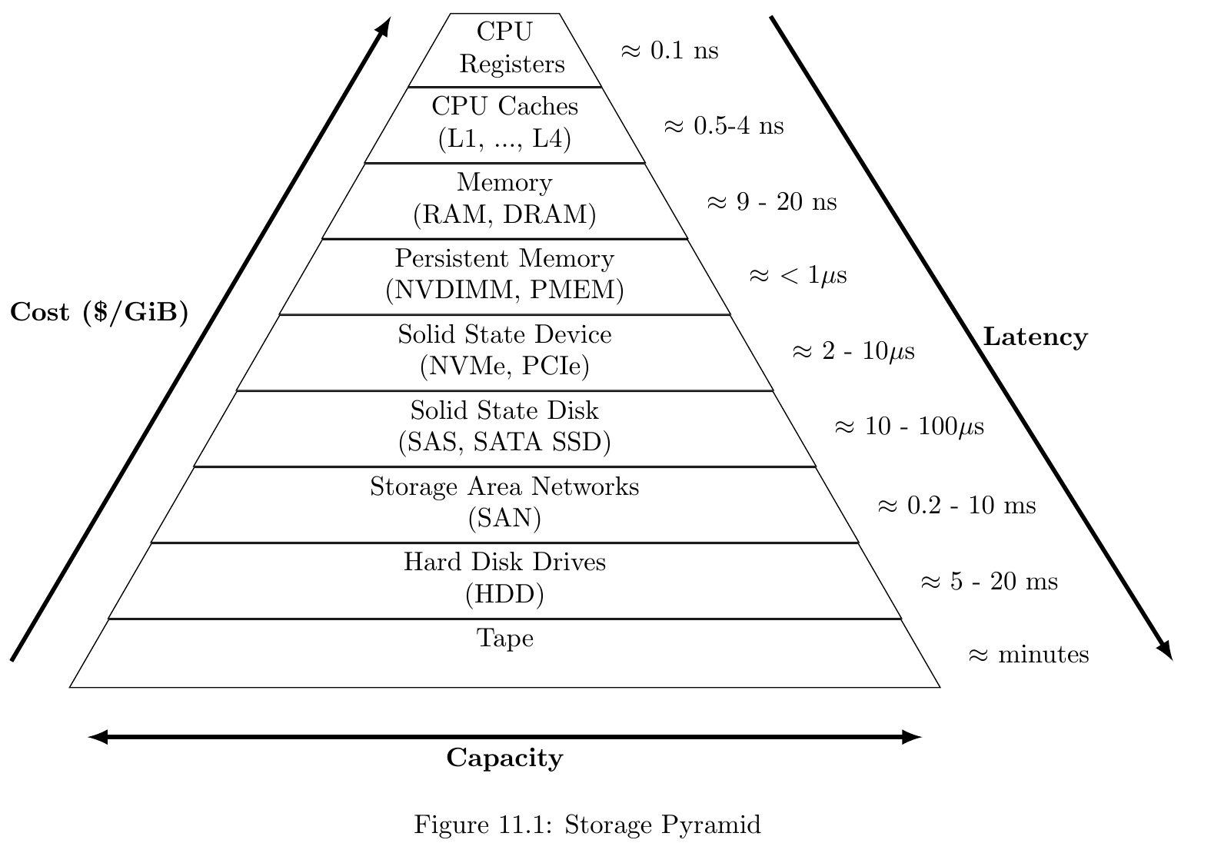
Storage Pyramid

Slide 42
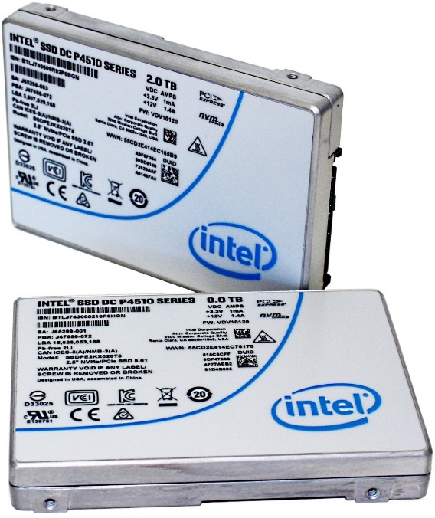
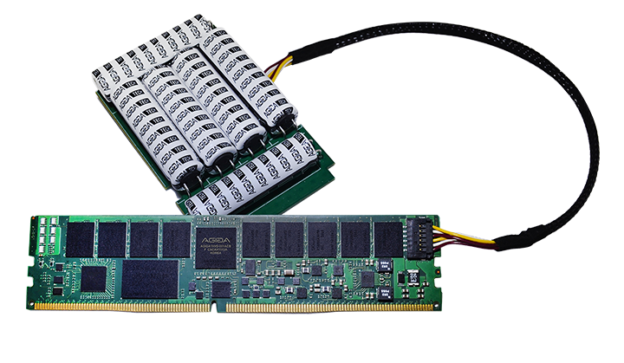
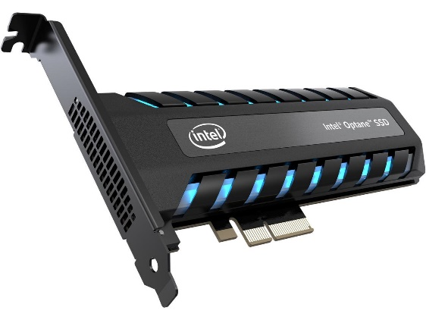
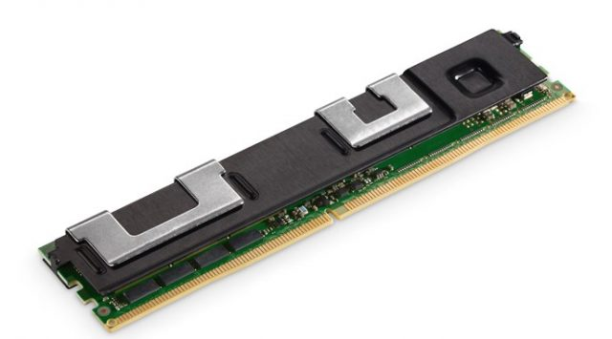
Current Storage Options
NVMe Disk
PCIe Card
NVDIMM
PMEM – Optane DC Persistent Memory
1 PB in about 70 Minutes
Latency measured in µs and ns
24 TB in about 300 seconds
1.5 TB in about 3 seconds

Slide 43

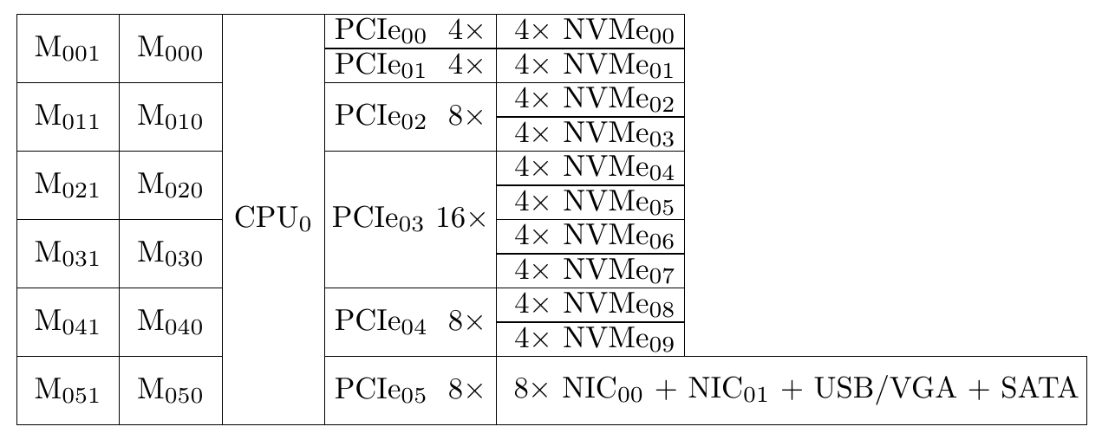

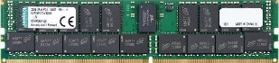

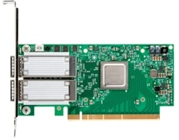
Low Latency Server (OLTP Workload)

Slide 44
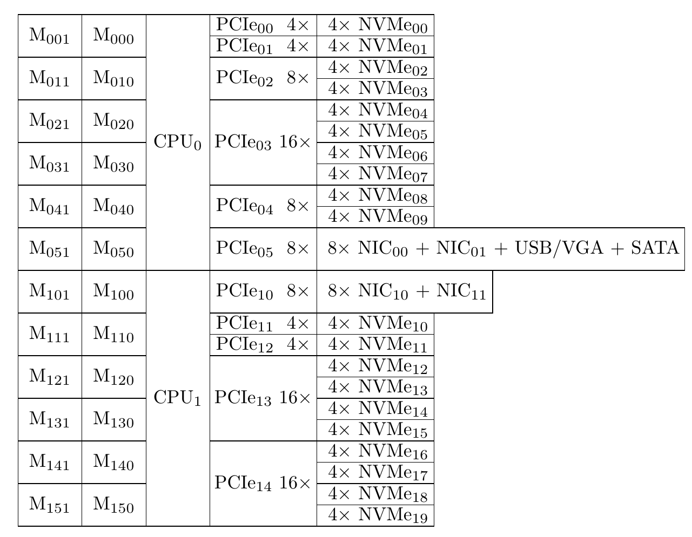
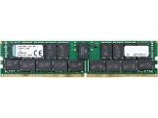


Commodity Server (Mixed Workload)
Two Socket Server (2 CPU’s, Intel or AMD)
Higher Latency
2 x Memory (4/6TB)
2 x Disk Capacity (~120TB usable)
2 x CPU (up to 112/128 Cores)

Slide 45
Balance the System Resources between CPUs

Slide 46

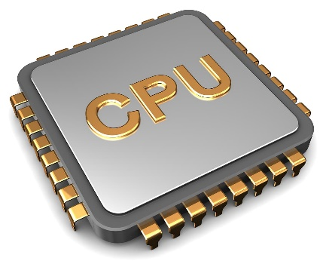
I/O Affinity
Set IO Affinity to one core of the CPU that has the NVDIMM connected
Same CPU needs to have the NVMe drive or PMEM connected which holds the logfile
Set CPU affinity for the NVMe driver to the same core
PERSISTENT_LOG_BUFFER = ON
(DIRECTORY_NAME=‘Path to NVDIMM Storage’ )

Slide 47
Set IO Affinity for
Low Latency
Few (maybe even just one) connections, fastest possible response time
High Concurrency OLTP
Lots of concurrent connections
High Throughput
DSS/DWH/Analytics
Few but complex requests touching a lot of data
Generic Server and Virtualization
Plus CPU Affinity and TF 8002

Slide 48
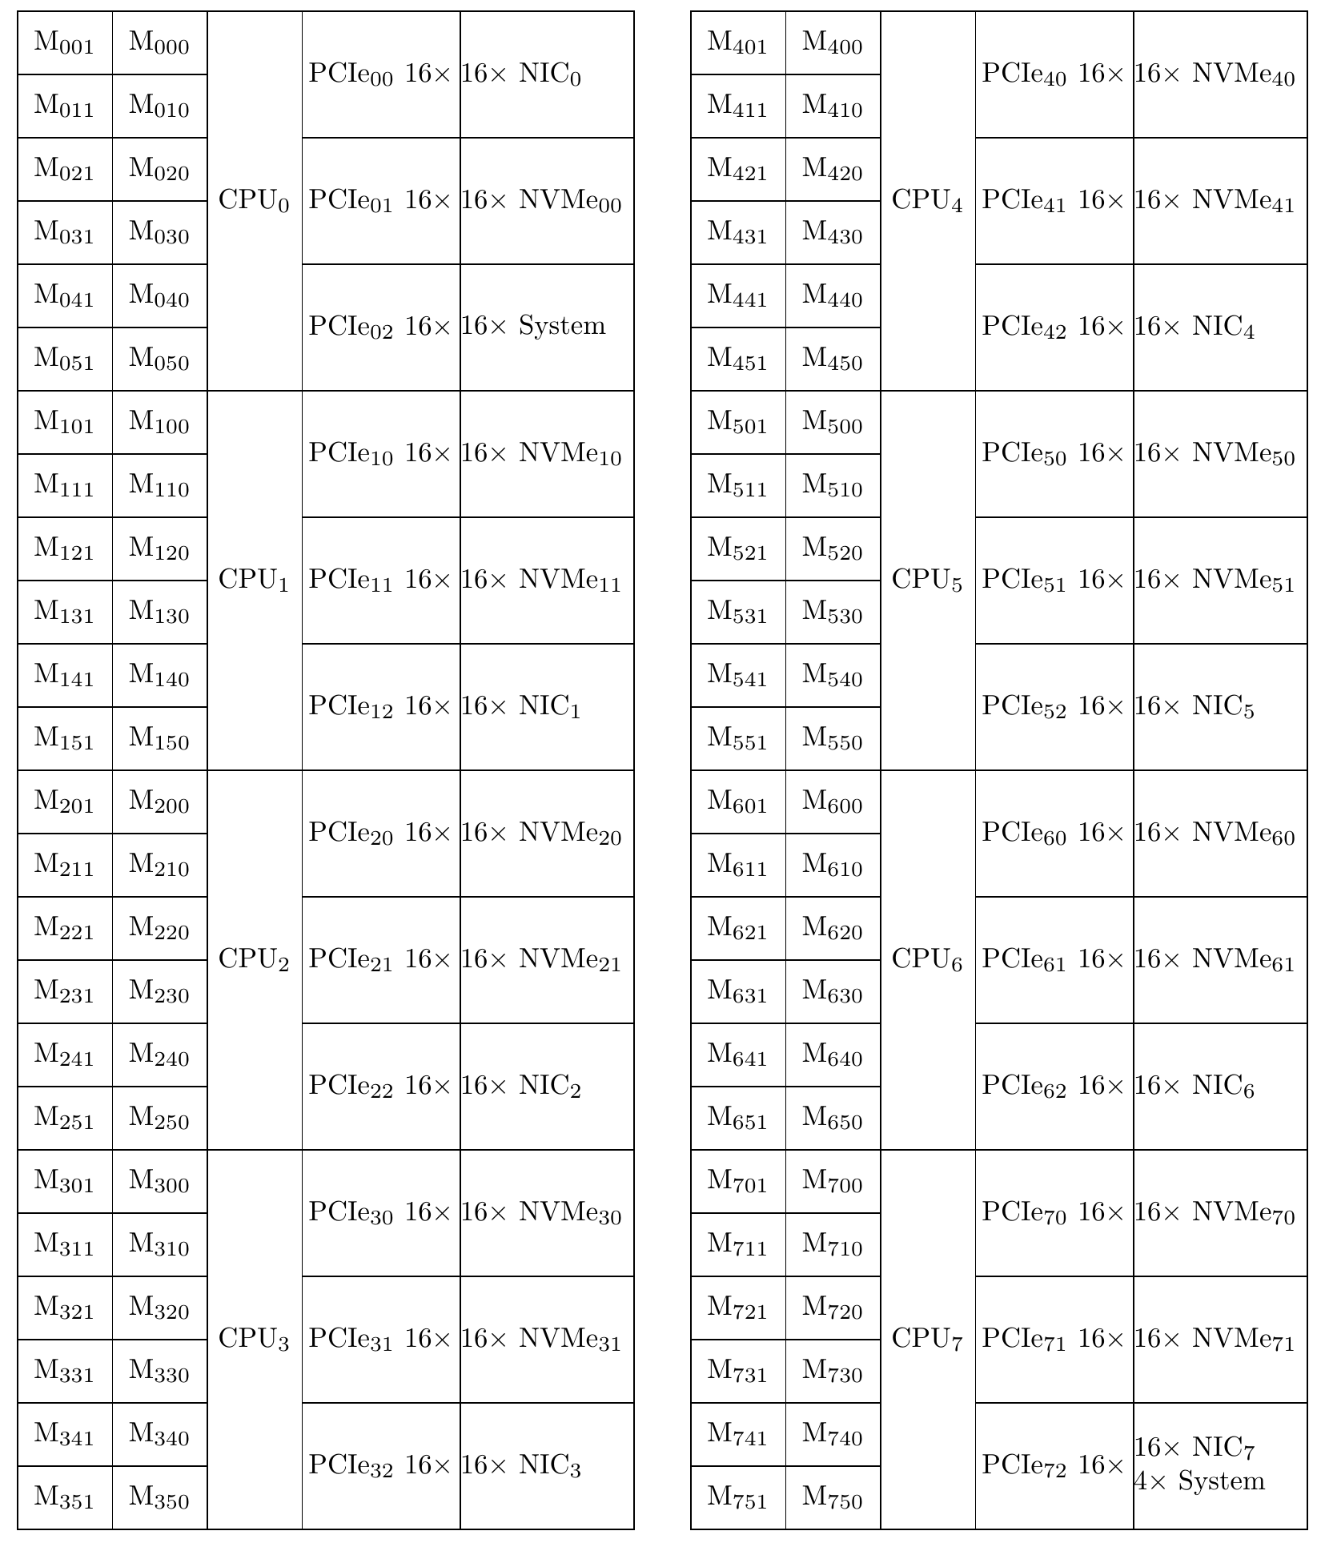
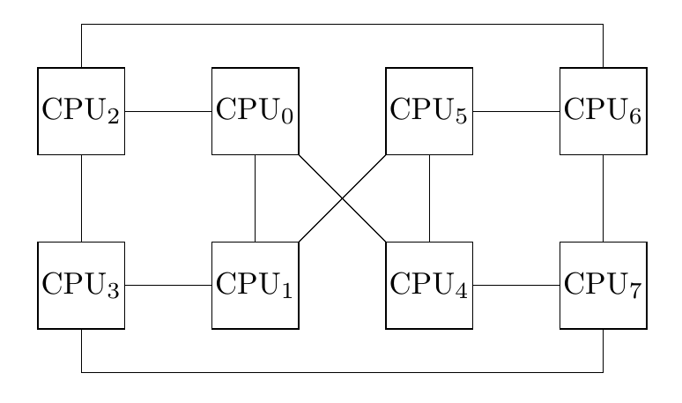
High Concurrency and Throughput
8 Socket Server (Intel 8 x 28 Cores)
→ 224 Cores

Slide 49
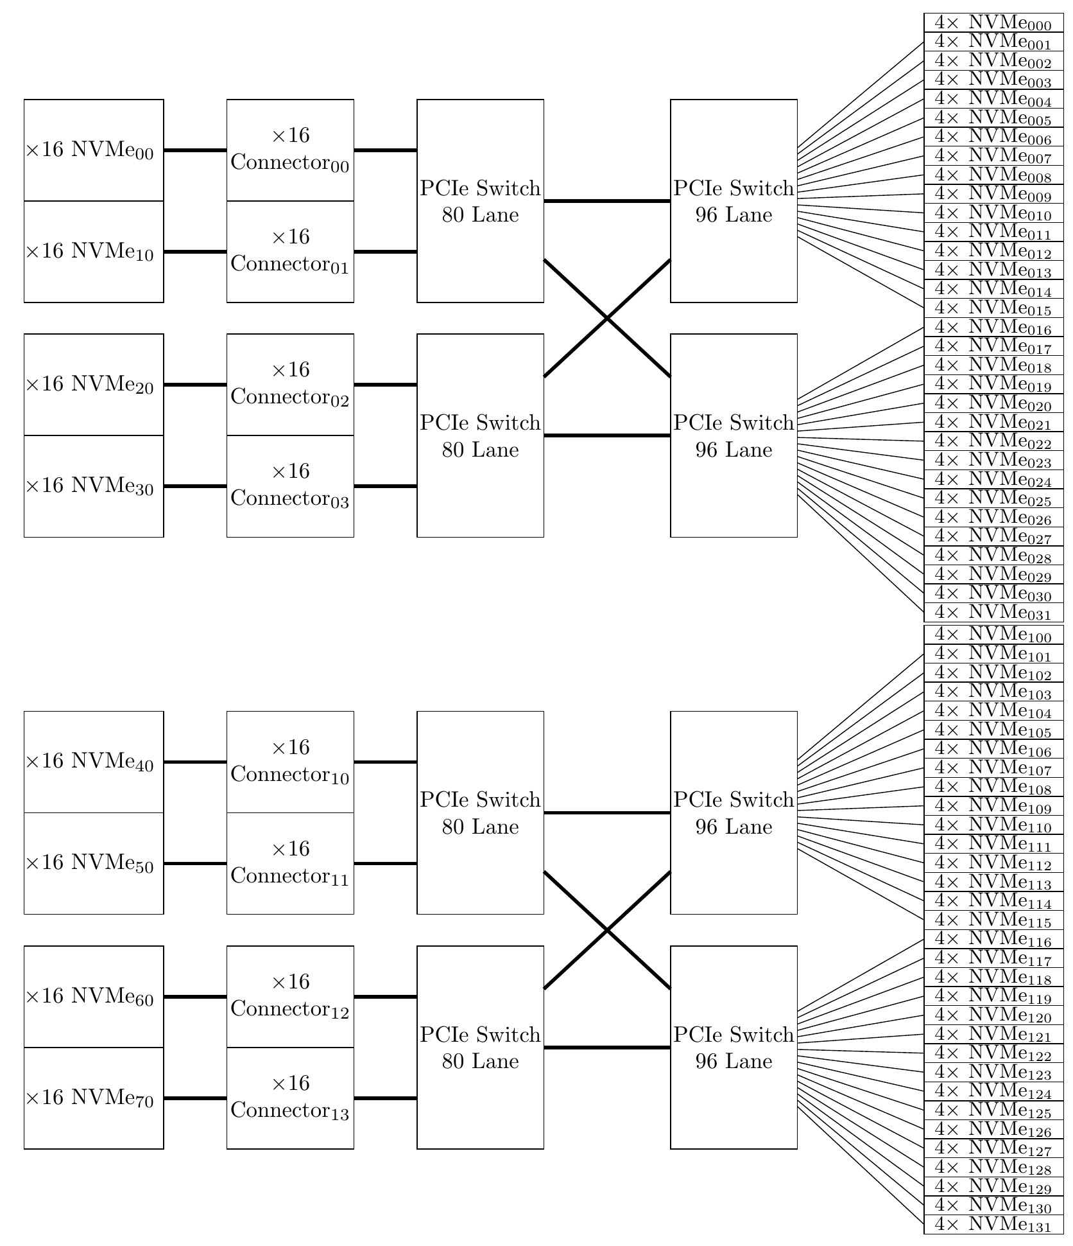
High Throughput Storage
Data
8 x PCIe 16 connectors
PCIe switches to
64 x PCIe 4x NVMe (4 or 8 TB)
Log
NVDIMM (if needed)
2 x PCIe 16x NVMe Card
TempDB
5 x PCIe 16x NVMe Card

Slide 50

Thank You Questions?
tg@grohser.com
https://eightkb.online/feedback/

